Slide 1
COVID-19 Vaccine Efficacy Trends
Exploratory Data Analysis Project
Name: Praya
Institute Name: GNCIPIL
Week 2: Data Visualization & Preprocessing

Slide 2
Project Objective And Theory
- Objective: analyze COVID-19 vaccination coverage trends
- Compare India, United States, Brazil, and Japan
- Study how fully vaccinated percentage changes over time
- Use EDA to understand patterns before advanced modeling
Project theory
EDA means Exploratory Data Analysis. In this project we load public data, clean it, transform useful columns, and use graphs to understand vaccination patterns clearly.
Important note
The dataset shows vaccination coverage percentage. So the analysis explains coverage trends and comparisons, not a medical trial result.
Source: Our World in Data public COVID-19 vaccination CSV

Slide 3
Dataset Overview
- Dataset: Our World in Data COVID-19 vaccination CSV
- Raw dataset shape: 77011 rows and 4 columns
- Selected dataset shape: 3604 rows and 4 columns
- Date range used: 2020-12-13 to 2024-08-12
- Main value: fully vaccinated percentage
Feature | Meaning
country | Country name
code | Country code
date | Record date
vaccinated_pct | Fully vaccinated percentage
year/month | Transformed date columns
Source: Our World in Data public COVID-19 vaccination CSV

Slide 4
Tools & Technologies
- Python
- Jupyter Notebook / VS Code
- Pandas
- NumPy
- Matplotlib
- Seaborn

Slide 5
Data Preprocessing
- Loaded public CSV using Pandas
- Checked shape, data types, and summary statistics
- Checked missing values and duplicate rows
- Dropped duplicates and filled values country-wise
- Converted date into year, month, and days since start
df_clean = df.drop_duplicates().copy()
df_clean['vaccinated_pct'] = df_clean.groupby('country')['vaccinated_pct'].ffill()
df_clean['vaccinated_pct'] = df_clean.groupby('country')['vaccinated_pct'].bfill()
df_clean['vaccinated_pct'] = df_clean['vaccinated_pct'].clip(0, 100)
Check | Output
Rows before cleaning | 3604
Duplicate rows before | 0
Rows after cleaning | 3604
Missing after cleaning | 0
Source: Our World in Data public COVID-19 vaccination CSV

Slide 6
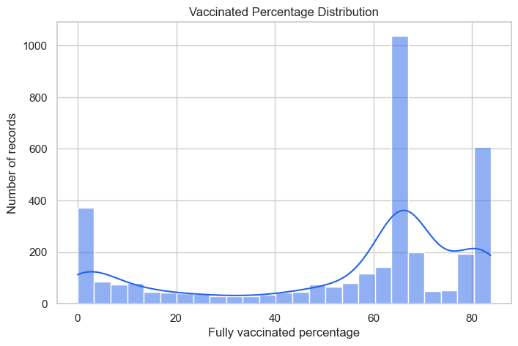
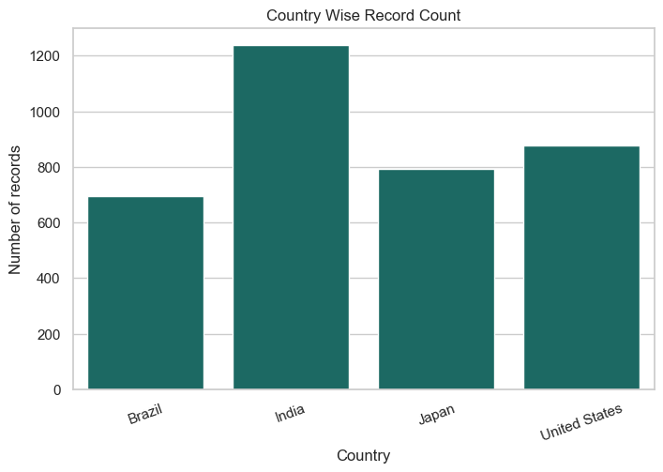
Univariate Analysis
What these graphs explain
The histogram shows how vaccination percentage values are distributed across all selected records. The count graph confirms how many records are available for each selected country.
- Distribution helps us understand spread
- Record count checks data balance
- Both are basic first steps in EDA
Source: Our World in Data public COVID-19 vaccination CSV

Slide 7
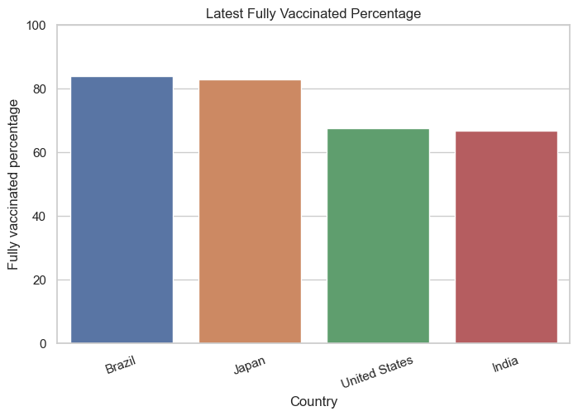
Latest Vaccination Comparison
83.8%
66.8%
Highest: Brazil
Lowest: India
What this graph explains
The bar chart compares the latest available fully vaccinated percentage for each country. Taller bars mean a higher latest vaccination coverage value.
Country | Date | Latest %
Brazil | 2023-03-22 | 83.8
Japan | 2023-12-31 | 82.8
United States | 2023-05-09 | 67.5
India | 2024-08-12 | 66.8
Source: Our World in Data public COVID-19 vaccination CSV

Slide 8
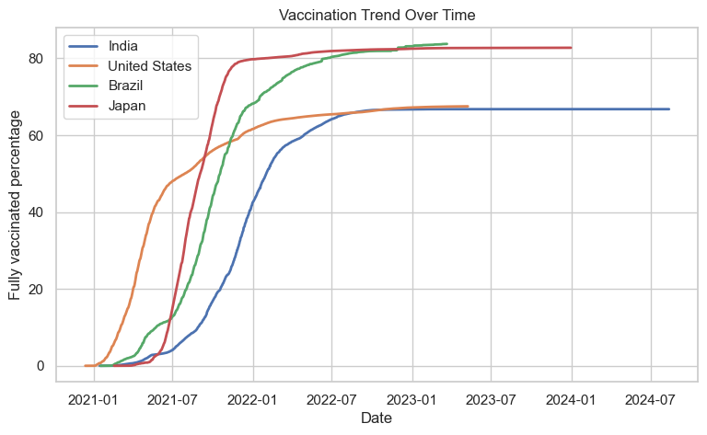
Vaccination Trend Over Time
What this graph explains
The line graph shows how vaccination coverage increased over time. Each line is one country. A steeper line means vaccination coverage increased faster during that period.
- X-axis: date
- Y-axis: fully vaccinated percentage
- Lines show country-wise trend
Source: Our World in Data public COVID-19 vaccination CSV

Slide 9
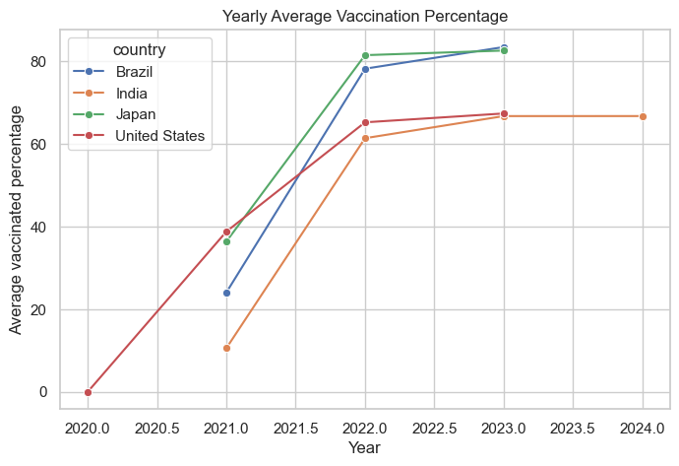
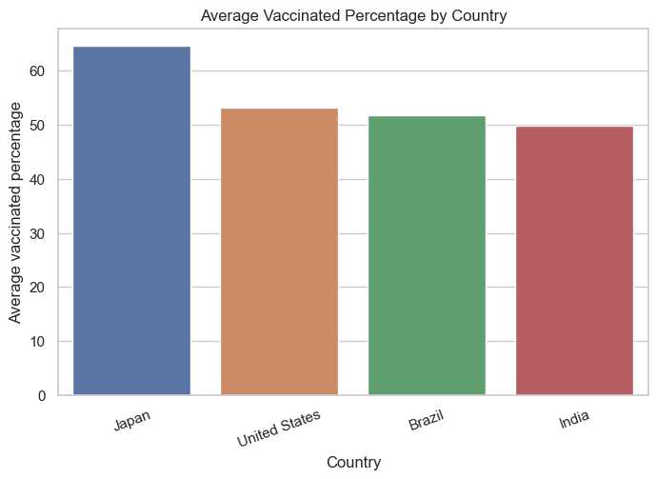
Yearly And Average Analysis
What these graphs explain
The yearly graph shows average vaccination coverage by year. The average bar chart summarizes the overall mean vaccination percentage for each country across the full dataset.
- Year comes from date transformation
- Yearly values simplify long timelines
- Average values give one overall summary
Source: Our World in Data public COVID-19 vaccination CSV

Slide 10
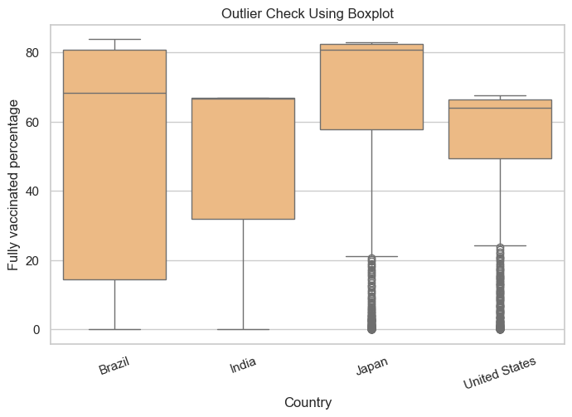
Outlier Analysis
What this graph explains
The boxplot helps check the spread of vaccinated percentage values for each country. Points far away from the box can indicate unusual values.
- Values are clipped between 0 and 100
- This avoids impossible percentage values
- Boxplots are useful for outlier checking
Source: Our World in Data public COVID-19 vaccination CSV

Slide 11
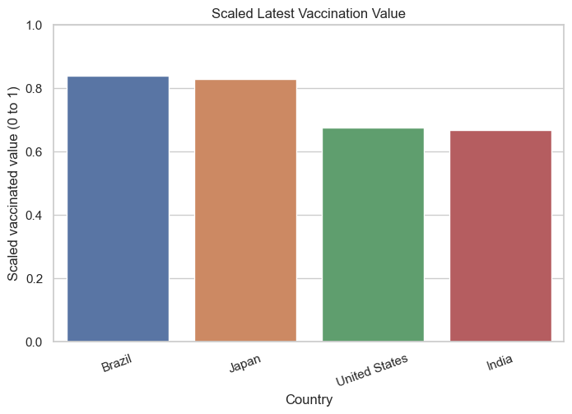
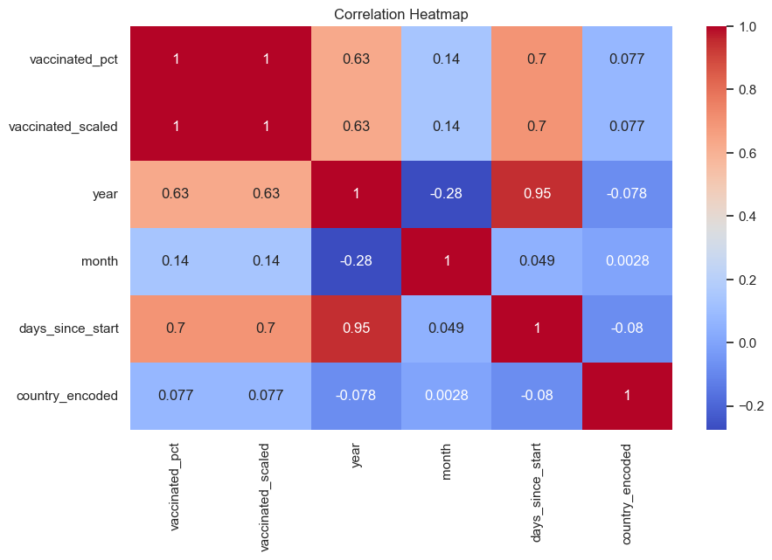
Encoding, Scaling And Correlation
What these graphs explain
The scaled bar chart shows the latest values after converting 0-100 into 0-1. The heatmap shows relationships between numeric columns. Darker red means stronger positive relation, while blue means negative relation.
- Encoding changes country text to numbers
- Scaling converts 0-100 into 0-1
- Scaled output is easier to read in ML steps
- Heatmap summarizes numeric relationships
vaccinated_scaled = vaccinated_pct / 100
country_encoded = factorize(country)
Source: Our World in Data public COVID-19 vaccination CSV

Slide 12
Key Findings
- Brazil has the highest latest value: 83.8%
- India has the lowest latest value: 66.8%
- Japan has the highest average vaccination percentage in selected records
- Missing values and duplicates were handled
- EDA gives clear country-wise and time-wise vaccination patterns
Source: Our World in Data public COVID-19 vaccination CSV

Slide 13
Conclusion
Exploratory Data Analysis helped us understand COVID-19 vaccination coverage trends for selected countries. The project completed dataset loading, preprocessing, transformation, encoding, scaling, visual analysis, and final insight generation.
Source: Our World in Data public COVID-19 vaccination CSV

Slide 14
Thank You
Questions & Answers

